Slide 1
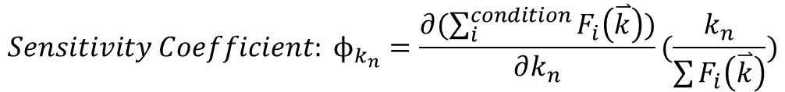
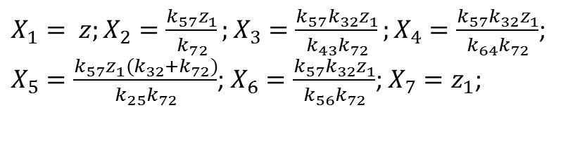
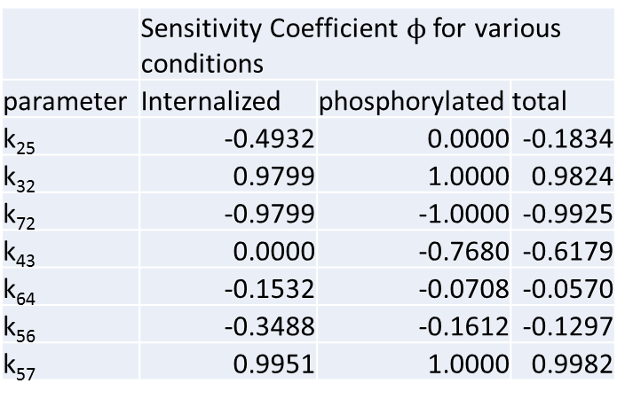


Differential Parameter Sensitivity Analysis
 | Sensitivity Coefficient $ϕ$ for various conditions
parameter | Internalized | phosphorylated | total
k₂₅ | -0.4932 | 0.0000 | -0.1834
k₃₂ | 0.9799 | 1.0000 | 0.9824
k₇₂ | -0.9799 | -1.0000 | -0.9925
k₄₃ | 0.0000 | -0.7680 | -0.6179
k₆₄ | -0.1532 | -0.0708 | -0.0570
k₅₆ | -0.3488 | -0.1612 | -0.1297
k₅₇ | 0.9951 | 1.0000 | 0.9982
$Parameter vector \overset{⃑}{k}=\{k_{25},k_{32}$, $k_{32}$, $k_{72}$, $k_{43}$, $k_{64}$, $k_{56}$, $k_{57},z,z_{1}\}$
$$z=x_{1}\left(0\right) ;z_{1}=X_{7}$$
$$Equilibirum amount of X_{j}=F_{i}\left(\overset{⃑}{k}\right)$$
$${Sensitivity Coefficient: ϕ}_{k_{n}}=\frac{∂(\sum_{i}^{condition}{F_{i}\left(\overset{⃑}{k}\right))}}{∂k_{n}}(\frac{k_{n}}{\sum{F_{i}\left(\overset{⃑}{k}\right)}})$$
$X_{1}= z;X_{2}=\frac{k_{57}z_{1}}{k_{72}};X_{3}=\frac{k_{57}k_{32}z_{1}}{k_{43}k_{72}};X_{4}=\frac{k_{57}k_{32}z_{1}}{k_{64}k_{72}}$;
$X_{5}=\frac{k_{57}z_{1}(k_{32}+k_{72})}{k_{25}k_{72}}$; $X_{6}=\frac{k_{57}k_{32}z_{1}}{k_{56}k_{72}}$; $X_{7}=z_{1}$;

Slide 2
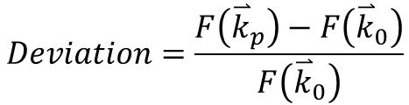
One-at-a-time Sensitivity Measures
$Reported vector {\overset{⃑}{k}}_{0}=\{k_{25},k_{32}$, $k_{32}$, $k_{72}$, $k_{43}$, $k_{64}$, $k_{56}$, $k_{57}\}$
$Pertubated vector {\overset{⃑}{k}}_{p}=\{k_{25}+∆k_{25},k_{32}$, $k_{32}$, $k_{72}$, $k_{43}$, $k_{64}$, $k_{56}$, $k_{57}\}$
$$Deviation=\frac{F\left({\overset{⃑}{k}}_{p}\right)−F\left({\overset{⃑}{k}}_{0}\right)}{F\left({\overset{⃑}{k}}_{0}\right)}$$

Slide 3
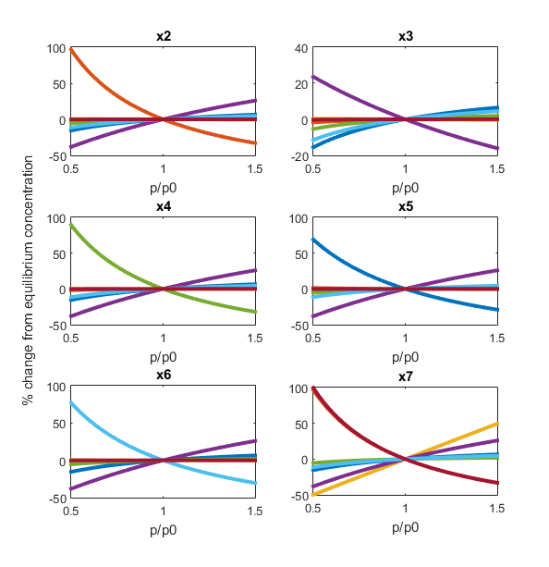
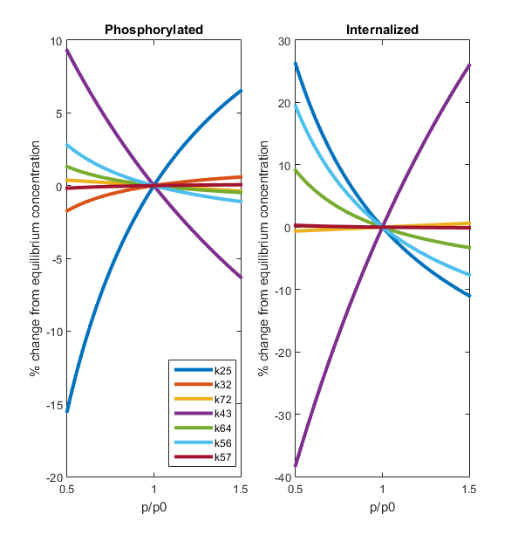
One-at-a-time Sensitivity Measures

